Slide 1


IT405
Final Presentation
MUSTAFA KÜÇÜK
01

Slide 2

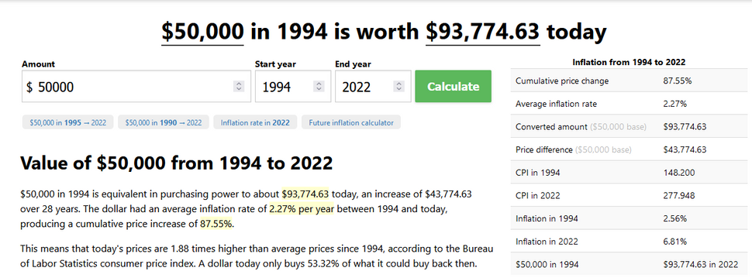
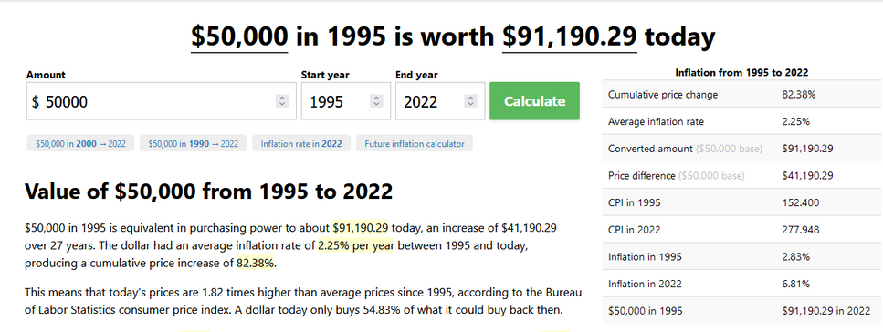

Goal
Determining whether people will earn more than $50k a year.
02

Slide 3

1. EDA
Advanced data exploration manually and with tools like pandas-profiling.
2. FEATURE ENGINEERING
Reducing high cardinality in categorical features by aggregating logically.
3. DETERMINE MOST IMPORTANT FEATURES
Comparing the model's feature importance and 𝜙k correlation matrix to determine rich features for model.
Pipeline
4. TRAIN A MODEL WITH SELECTED FEATURES
Training a model with determined features for faster and accurate predictions.
5. TUNE THE MODEL
Tuning the model with both Random and Bayesian search and using the best model for predicting test data.
03

Slide 4




EDA & Feature Engineering
Impute missing values with mode
Marital Status
Class of Worker
Education
2
1
3
4
Initial EDA with pandas-profiling
High Cardinality?
Aggregate Substantial Features
5
6
Check ϕK correlation
Check the baseline models' feature importance figures
Determine the most informative features
04

Slide 5







Model Development
Train CatBoostClassifier
Tune Model with Bayesian and Random search
Determine Best Features
Census Data
Binary Classification
Classify
Test Data
Save
Best Model
05

Slide 6




Tools
Why Catboost?
State-of-the-art categorical variable encoding (Ordered Target Encoding)
The fast and scalable GPU version
All-in-one framework for low latency requirements
Feature importance graph
ϕK Correlation Analyzer
BayesOpt
06

Slide 7
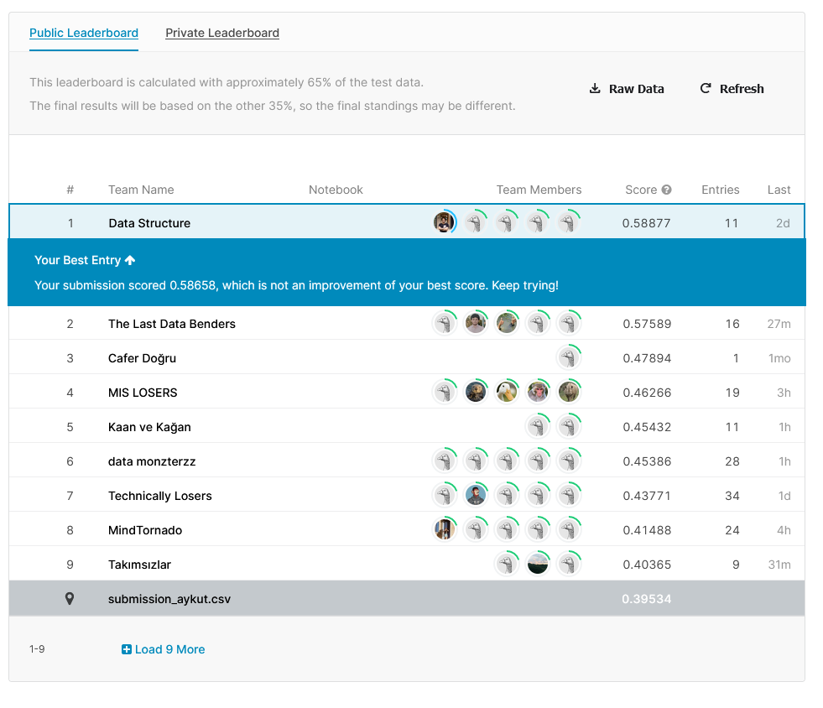
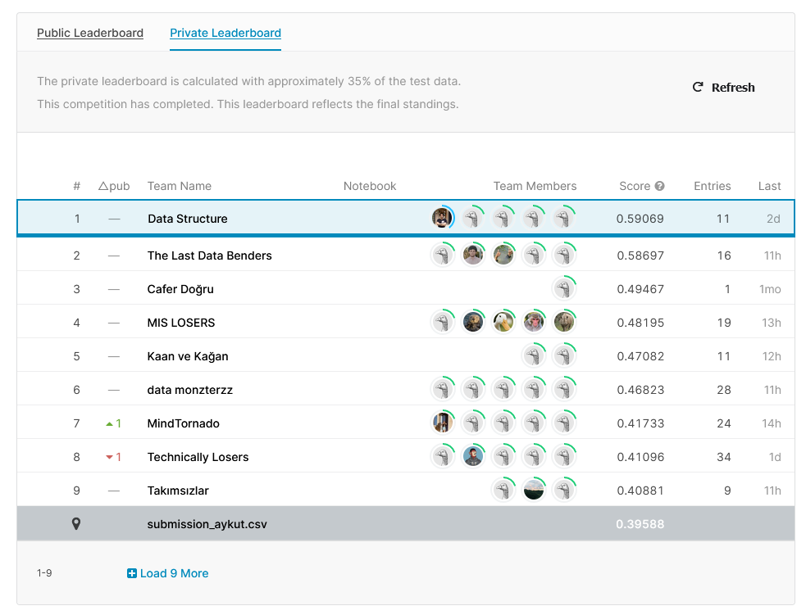
Results
07

Slide 8
Thank
you!

